Slide 2
Introduction to SQL DW
Ron Ortloff
Azure SQL DW
Sr. Program Manager
rortloff@microsoft.com
@RonOrtloff

Slide 3
Changes in Data Warehouse space
Integration with unstructured data
Drive to the cloud
Hardware renewal
Support costs
SQL

Slide 4



Introducing Azure SQL DW Service
A relational data warehouse-as-a-service, fully managed by Microsoft.
Industries first elastic cloud data warehouse with proven SQL Server capabilities.
Support your smallest to your largest data storage needs.
Elastic scale & performance
Market Leading Price & Performance
Powered by the Cloud
Azure
Azure
Get started in minutes
Integrated with Azure ML, PowerBI & ADF
Scales beyond petabytes of data
Cloud DW Scale-out Processing
Instant-on compute scales in seconds
Query Relational / Non-Relational
Saas
Simple billing compute & storage
Pay for what you need, when you need it with dynamic pause
Azure
Office 365
Office 365
Public
Cloud

Slide 5
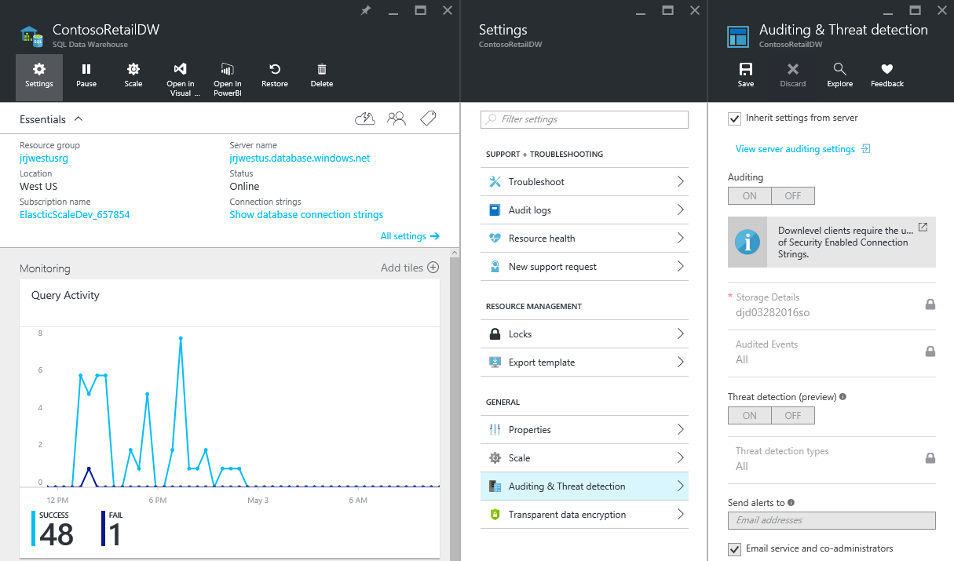
Fully managed PaaS
Notes:
Fully managed

Slide 6
Base Patterns

Slide 7
Suitable workloads
Analytics
Store large volumes of data.
Consolidate disparate data into a single location.
Shape, model, transform and aggregate data.
Perform query analysis across large datasets.
Ad-hoc reporting across large data volumes.
All using simple SQL constructs.
“SQL on SQL”

Slide 8
Unsuitable workloads
Operational workloads (OLTP)
High frequency reads and writes.
Large numbers of singleton selects.
High volumes of single row inserts.
SQL
Data Preparation
Row by row processing needs.
Incompatible formats (JSON, XML).
SQL

Slide 9






Resume / Pause Pattern
Persist
Export
Query
Stream
Import
Import
Resume
Ingest
Aggregate
Export
Pause
Lower Cost
High Concurrency
“Dashboard Query”
Notes:
Red Stars
Archive on the way in to the warehouse
Geo-redundant blob storage guarantees your data
Allows for RPO 0 Data Warehouse architectures
Allows for point in time restart-ability of ELT
Resume / Pause Pattern

Slide 10

SaaS customer isolation
DWU 200
DWU 600
Customer
Clickstream
Corporate
DWU 1200
Notes:
Red Stars
Consistent single view of raw data held in Blob Storage accessible by all consumers of data
Customer specific DWU settings allowing for simple chargeback models

Slide 11


Big Data & SQLDW
Unknown Value Data
XML
High Value Data
JSON
TEXT
Model
Load
Transform
Aggregate
Consume
Data Preparation
Pre-process
Transpose
Re-format
Batch
Ad-hoc
Batch

Slide 12
Under the hood - Architecture

Slide 13
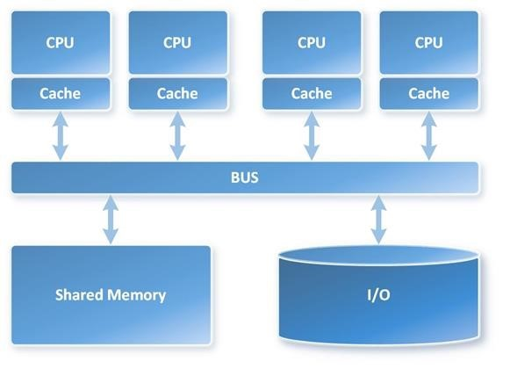
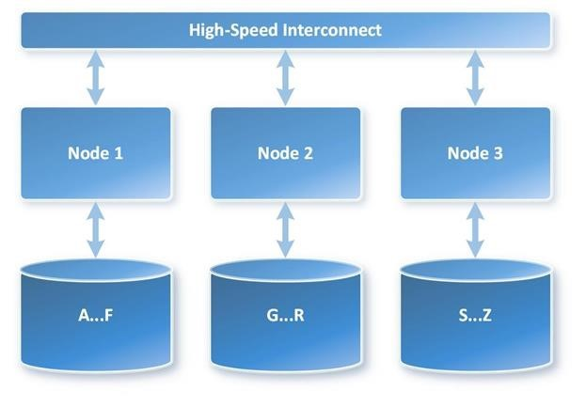
MPP vs. SMP Architecture
VS

Slide 14
SQL DW Fundamentals
Control
Control
Connection and tool endpoint. Coordinates compute activity.
Engine
DMS
SQL DB
Compute
Handles query processing, ability to scale up/down
Compute
Compute
Compute
Compute
DMS
DMS
DMS
DMS
SQL DB
SQL DB
SQL DB
SQL DB
Dist_DB_1
Dist_DB_2
Dist_DB_15
Dist_DB_16
Dist_DB_17
Dist_DB_30
Dist_DB_31
Dist_DB_32
Dist_DB_45
Dist_DB_46
Dist_DB_47
Dist_DB_60
DMS: Data Movement Services
Coordinates data movement between nodes
…
…
…
…
Azure Blob Storage
Storage
Remote storage. Scales independently of compute
Notes:
Compute Node VM hosting two key components of SQL DW.
These two key SQL DB and DMS.
DMS, stands for Data Movement Service
cover more later on why move data
SQL DB crunching the data and DMS moving
Third component to SQL DW, the Engine.
primary function is to optimize and manage incoming work.
Engine parses and creates query plans.
Compute node has several SQL databases.
MPP
60 databases equally divided
This example is DW500, each compute node is hosting 12 databases.
Let’s say we want to take this DW500 and scale it up to a DW1000
What happens behind the scenes?
(1) take all of the SQL Databases down, (2) add 5 more compute nodes
(3) start up the SQL DB databases again.
some of the databases are on different compute nodes
6 distributions per node rather than 12
Each Node has half the work now

Slide 15
Data Warehouse Units
DWU
100
200
300
400
500
600
1000
1200
1500
2000
3000
6000
…
30000
Normalized amount of compute
Converts to billing units i.e. what you pay
CPU
RAM
I/O

Slide 16

Separate compute from storage
SQL
Control
Compute
Premium Storage
Notes:
De-coupled storage from compute & control
Completely elastic
Pay for the data you store and the compute you provision

Slide 17
Independently scale compute
SQL
Control
Compute
Premium Storage
Notes:
De-coupled storage from compute & control
Completely elastic
Pay for the data you store and the compute you provision

Slide 18
Pause and resume workload
SQL
Control
Compute
Premium Storage
Notes:
De-coupled storage from compute & control
Completely elastic
Pay for the data you store and the compute you provision

Slide 19


Management Interfaces
 | Portal | PowerShell | T-SQL
Create
Pause and resume
Scale

Slide 20
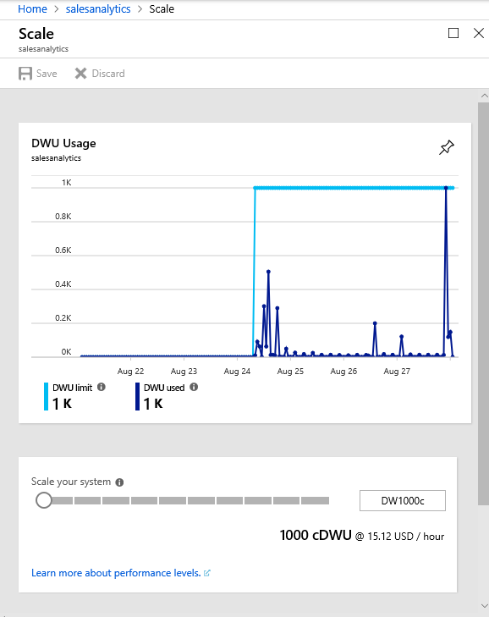
Scaling in the Portal

Slide 21
Scaling via T-SQL and PowerShell
T-SQL
ALTER DATABASE ContosoRetailDW
MODIFY (service_objective = 'DW100');
PowerShell
Set-AzureRmSqlDatabase `
–ResourceGroupName "RG_name" `
–ServerName "SRV_name" `
–DatabaseName "DB_name" `
-RequestedServiceObjectiveName "DW1000"

Slide 22
Query Execution
Result
Query
SQL
Control
Compute
Premium Storage
Notes:
De-coupled storage from compute & control
Completely elastic
Pay for the data you store and the compute you provision

Slide 23
Distributing Data
CREATE TABLE [build].[FactOnlineSales]
(
[OnlineSalesKey] int NOT NULL
, [DateKey] datetime NOT NULL
, [StoreKey] int NOT NULL
, [ProductKey] int NOT NULL
, [PromotionKey] int NOT NULL
, [CurrencyKey] int NOT NULL
, [CustomerKey] int NOT NULL
, [SalesOrderNumber] nvarchar(20) NOT NULL
, [SalesOrderLineNumber] int NULL
, [SalesQuantity] int NOT NULL
, [SalesAmount] money NOT NULL
)
WITH
(
DISTRIBUTION = HASH([ProductKey])
)
;

Slide 24
Row Store & Column Store

Slide 25
Scale out = Distributed tables
ROW STORE
COLUMN STORE

Slide 26
Data Loading

Slide 27
Data Loading
Polybase and T-SQL
ADF – (with Polybase)
SSIS – (with Polybase)
BCP
3rd Party tools

Slide 28
WHAT does PolyBase do?
Load Data
Use external tables as an ETL tool to cleanse data before loading
Age-out Data
Age data to HDFS or Azure Storage as ‘cold’ but query-able.
Interactively Query
Analyze relational and non-relational data together
HOW does it do it?
Imposes structure on semi-structured data
Define external tables over data
Reads/Writes Hadoop file formats
Text, CSV, RCFILE, ORC, Parquet, Avro, etc.
Parallelizes Data Transfers
Direct loads to service compute nodes

Slide 29
Parallel Load
Compute Node
Azure Storage Blob (ASB)
DMS
Bridge
Control Node
Compute Node
DMS
DMS
Bridge
Compute Node
DMS
Bridge
Notes:
BCP and SSIS come through the “front-door” Control Node

Slide 30
Data Protection

Slide 31
Backup Options
Automatic Restore Points
Snapshots taken automatically by the system.
Every few hours for an 8 hour RPO
Maintained for 7 days.
On by default, cannot be disabled.
User-Defined Restore Points
NEW!
Manually triggered
Good for snapshots before large data modifications
Can also be used to restore reporting offload instance.
Can maintain update 42 restore points.

Slide 32
Geo-redundancy
Notes:
Platform as a Service (PaaS)
Leverages the cloud
Database snapshots are taken on a regular basis to support a global 8 hour RPO
A geo redundant snapshot can be used to bring online the database in any region
1 backup a day made available
Standard RA-GRS rates (per GB)
Charged for full size of the backup

Slide 33
Workload Management

Slide 34
Concurrent queries
QID
QID
128
active queries
1024
open sessions
QID
QID
QID
QID
Notes:
128 coming soon…

Slide 35
Resource classes
Dynamic
Increases resource consumption as you scale
No increase in concurrency as you scale
Static
Maintain resource consumption as you scale
Increase concurrent queries as you scale
Consume Slots
Increase memory
Isolate resources
Notes:
Key point:
-Dynamic: as you scale, queries have more slots and ram to run faster, not more of those queries.
-Static: as you scale, queries have the same amount of slots and ram, you can run more of them.

Slide 36
Monitoring

Slide 37
Monitoring Options
Azure Portal
Common interface
Alerts
Recommendations
Rention periods
Operations Management Suite (OMS) integration
Command-line
Rich set of DMVs
Lower level of diagnostics

Slide 38
Azure Portal
Key Metrics
CPU Percentage
IO Percentage
DWU (limit, used and percentage used)
Connections (successful, failed, blocked by firewall)
Gen2: Cache metrics (used and cache hit percentage)

Slide 39
Execution DMVs
Sessions
Data Movement Steps (DMS)
dm_pdw_exec_sessions
session_id (PK)
dm_pdw_dms_workers
request_id (PK)
step_index (PK)
Queries
dm_pdw_exec_requests
request_id (PK)
session_id
SQL Queries (On Operations)
Waits
Query Plan Steps
dm_pdw_sql_requests
request_id (PK)
step_index (PK)
dm_pdw_waits
request_id (PK)
object_name (PK)
dm_pdw_request_steps
request_id (PK)
step_index (PK)

Slide 40
Azure SQL DW Take-aways
No CAPEX
Low OPEX
Provision in just 5 minutes
Scale in seconds
Fully parallel load
Fully managed platform
Time to insight measured in minutes
SQL

Slide 41
Additional Resources
Azure site: http://aka.ms/sqldw
SQL DW suggestions: http://aka.ms/sql-dw-feedback
Stack Overflow – Tag: azure-sqldw
Twitter: @AzureSQLDW

Slide 42
Q&A

